Slide 1
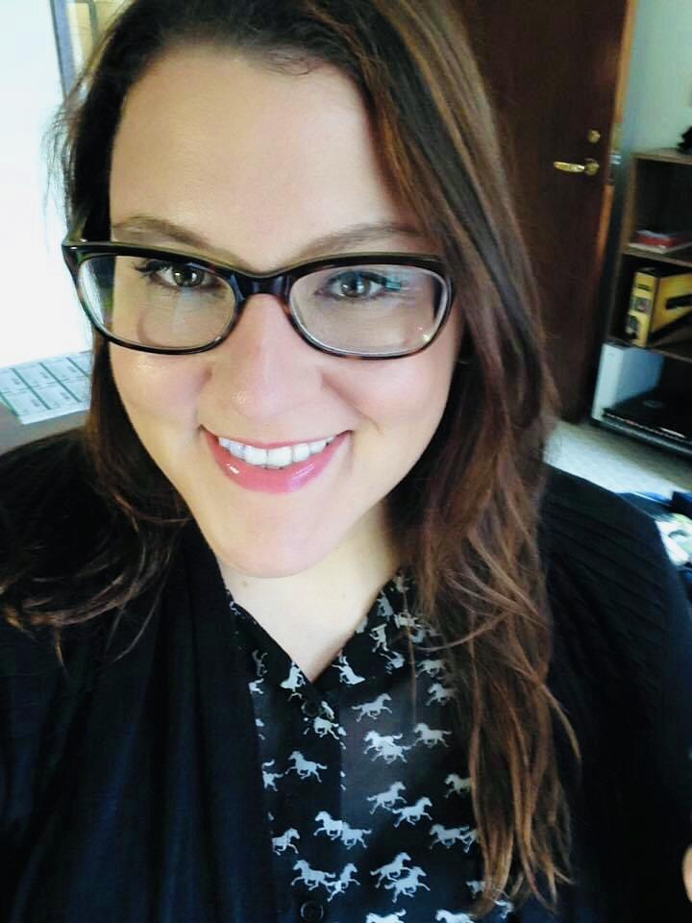
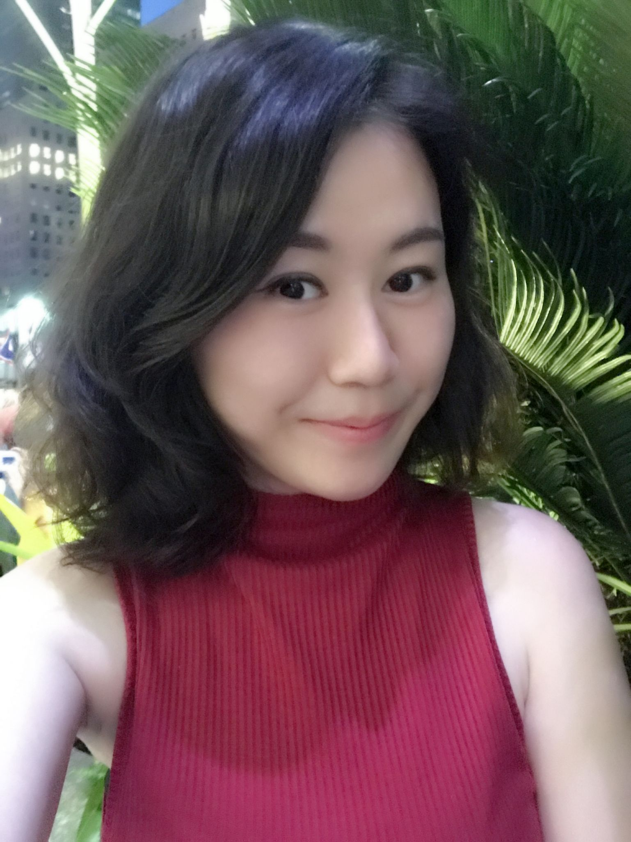
A Qualitative Analysis of the Role of Communication in Reputation Management During Compounding Health Crises
Shawna L. DIas
Ph.D. Candidate
Xiaojing (Romy) Wang
Ph.D. Candidate

Slide 2
Purpose of this study
To gain an understanding of how communication is impacted during a compounding health crisis, and how reputation threat and social capital loss may be mitigated.

Slide 3

Case Background
Death of Jordan McNair
Dormitory Mold
Adenovirus Outbreak

Slide 4
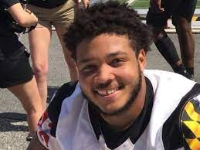
Death of Jordan McNair
May 29, 2018 - Hospitalized for heat stroke after a football practice
Received emergency liver transplant, but died 15 days later.
March 3, 1999 - June 13, 2018
Notes:
Offensive lineman for Maryland football. He had a temperature of 106 degrees F upon arrival at the hospital. Teammates reported that Jordan experienced a seizure at practice one hour before 911 was called, but the University’s officials dispute this timeline. Trainers failed to follow heat stroke treatment protocols by not providing an ice bath and delayed emergency services by not providing the team’s exact location information. Following the event, ESPN launched an investigation into McNair’s death and determined there was a “toxic” athletic culture at the University. Board of Regent’s commissioned an investigation into the event and the athletic culture at the university, and the school’s accreditation was came under review.

Slide 5
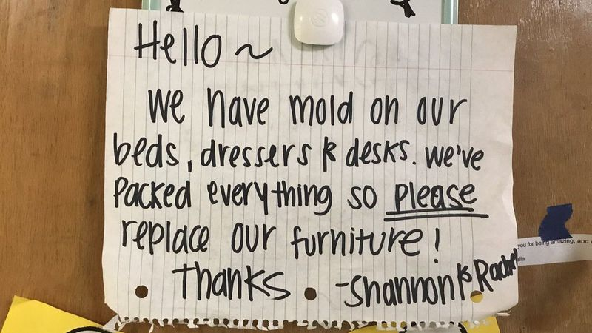
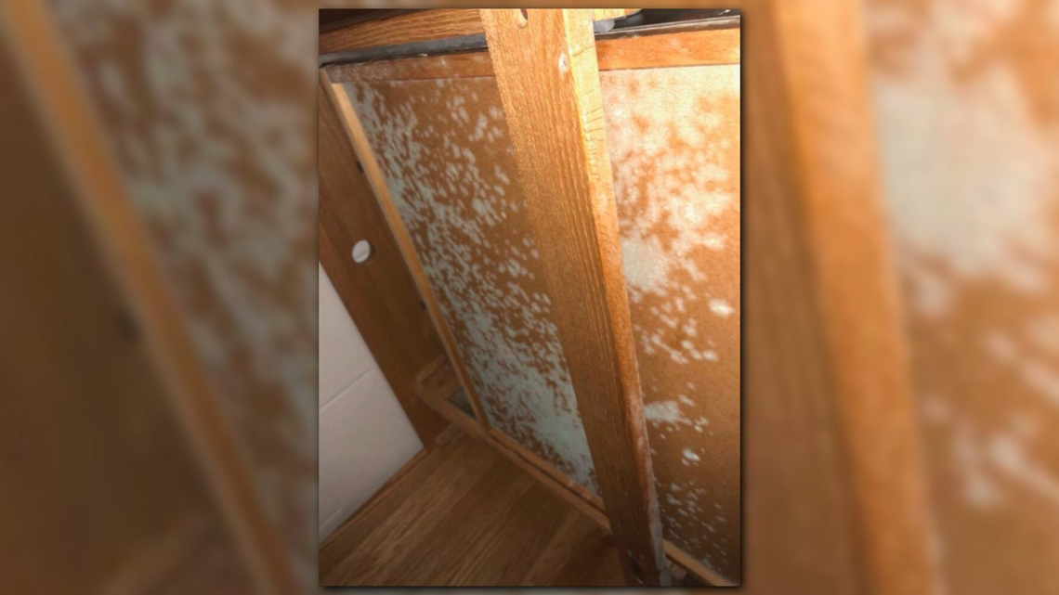
Dormitory Mold
September - October, 2018
Students in Elkton Hall and other dormitories began reporting mold on furniture, walls and windows.
Many students began showing symptoms of respiratory infections and increased asthma attacks.
500 students were moved into nearby hotel rooms until the dormitories could be cleaned.

Slide 6
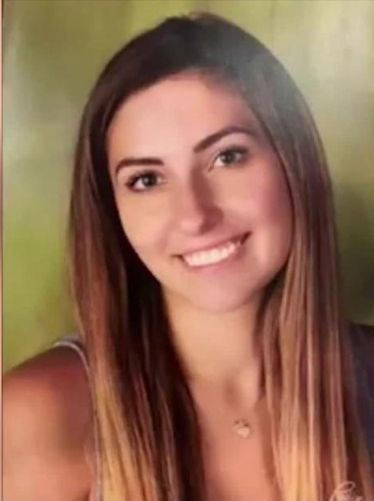
Adenovirus Outbreak
Nov. 19, 2018 - 1st message from UMD Health Center to Students about the outbreak. Six students confirmed sick at this point.
Nov. 20, 2018 - students were informed about the death of Olivia Paregol.
At least 44 students would be confirmed infected between November 2018 - January, 2019.
Olivia Paregol
June 17, 2000 - November 18, 2018
Notes:
Adenovirus presents similarly to the cold and flu viruses, but symptoms may more quickly become severe and persist for longer periods of time, and persons with immunodeficiencies or respiratory diseases are at elevated risk for the most severe symptoms. There are more than 40 serotypes of adenovirus, but Ad-7, which was present in several of the infected students is one of the most severe. The University faced parent and public criticism for failing to warn about the possibility of an outbreak.

Slide 7
Compounding Crises & SCCT
Compounding Crises are crises which happen “in close succession to another (potentially unrelated) crisis before an organization has had the opportunity to rebuild its legitimacy” (Veil & Anthony, 2017, p. 142)
SCCT focuses on public perceptions of an organization following a crisis. It assumes that organizations undergoing crisis are reputation-driven and provides a menu of strategies that organizations can apply to maintain or repair their reputations (Coombs & Holladay, 2002; Sellnow & Seeger, 2013).
Filling the Gaps in SCCT: Applied principles of OPR and Excellence Theory
Notes:
Compounding crises are often confused with spillover or cascading crises.A spillover crisis occurs when one organization’s crisis causes hardship or reputational damage to one or more other organizations; this is most likely to happen when the organizations are directly affiliated (Igenhoff et al., 2018; Veil et al., 2016). A cascading crisis happens when one event serves as a catalyst for failures in other parts of a system (Veil & Anthony, 2017; Veil & Husted, 2012). SCCT offers four categories for strategic post-crisis communication: denial, diminishment, rebuilding, and bolstering.
One limitation for applying SCCT to this study is that it predominantly focuses on post-crisis communication and does not fully account for how organizations manage communication mid-crisis.

Slide 8
Research Questions
RQ1
How did the University manage communication with their publics during the 2018 compounding crises?
RQ2
How, if at all, did the University’s crisis communication management practices changed following the compounding crises?
Notes:
The research questions for this study considered how the University’s communication managers may have applied crisis communication and relationship management theories, frameworks for communication which are intended to mitigate reputational threats caused by a crisis, and whether or not the University’s communication practices changed in the wake of the compounding crises.

Slide 9

Method
Semistructured Interviews with 3 of UMD’s public relations managers (Ryan, Sarah, & Brianna).
Analysis of UMD artifacts (emails, official communication protocols, & social media posts)
Analysis of online dialogue with publics, news article comments, and social media comments.
Notes:
Interviews - A senior UMD official tasked with strategic communication, a communication specialist from UMD’s Health Center, & a communication specialist from UMD’s recreation and wellness program. Artifacts - pulled from received emails (6), public social media, and materials provided by interview participants. Social Media - comments & dialogue gathered via WebScraper.io. Otter.Ai used for transcription of recorded interviews
NVivo used for thematic analysis of all materials

Slide 10
Findings: Communication Planning
When compounding crises occur, communication planners prioritize the crisis that would affect the largest number of stakeholders.
“One solid piece of our structure is that we maintain constant communication with the University’s senior leadership, I would say on an hourly basis, during crisis.”
Health warnings to the campus may be delayed, because communication specialists follow CDC guidelines about when to communicate risks.
“There is a large population of people on campus each day, upwards of 50,000 people, and there’s a certain amount of infectious disease that exists in that population all of the time.”

Slide 11
Findings: Communication Planning
During past crises, conversations were limited to senior leadership in strategic communication and the heads of individual units affected by the crisis. During the 2018 compounding crises, protocols changed to include less senior staff and more lower-level staff in decision-making meetings. The intent was to become more aware of diverse perspectives and ways that communication might be interpreted by different stakeholders.
“Tone changes how the message is received. It can improve the message or damage it. When students receive health messages in a tone that implies the creator was cautious or not transparent, as many messages from strategic communications inherently are, they are less likely to perceive the message as being credible or in their best interest.” (Sarah)
“As soon as something becomes a crisis, they would be working with us, but there is group decision making. I might recommend something, but we need agreement to move forward.” (Brianna)
Notes:
Sarah also mentioned that this change in protocol helps communicators to better understand the tone of their message.
Although individual units have a substantial amount of decision-making agency over the communication for their department, the office of strategic communication becomes involved as soon as issues escalate to a crisis stage. Departments are able to offer recommendations, but Strat Comm has veto power.

Slide 12
Findings: Reputation Management
UMD’s Strategic Comm Dept. considered reputation a high concern - prioritized external publics, alumni, and donors as message receivers and ignored communication theory.
The Health Center & Recreation and Wellness program considered reputation a secondary concern - prioritized students as message receivers. The Health Center adopted health communication theories.
“When major crisis happens, day to day management gets sidelined and 90% of activity is oriented around the crisis.”
“When major crisis happens, day to day management gets sidelined and 90% of activity is oriented around the crisis.”
“I use what I know to be ‘best practices’”

Slide 13
Findings: Relationship Management
The health center and recreation and wellness departments did not measure responses to their messaging, and only engaged in dialogue when emails were received directly from their publics.
“We haven’t tested the effects of our messages, so i don’t have any empirical evidence to prove that it was well-received, but we track the engagement and I know that the adenovirus health messages on our social media had a high level of engagement.”
(Ryan)
Notes:
Ryan (Strat Comm) said that a staff member in his department was actively responding to social media comments, our analysis of the Facebook and Twitter scrape showed no real dialogue occurred between the University and its online publics who responded to the adenovirus messaging. The overall tone of messages that were posted by members of the public on the University’s social media was “concerned”. This mirrored the tone in the messages that were directed to the University’s health center. However, the tone of messages posted by publics to personal Facebook pages, on personal Twitter profiles, and on the comments section of online news articles was predominantly “disappointed” and “criticizing”.

Slide 14
Findings: Changes to Communication Protocols & Practices
In the wake of the compounding-crises, the three participants formed a committee which drafted a new crisis communication plan for UMD to roll out at the department level.
It defined crisis a “an incident that negatively impacts our community (professional staff, student staff, members, an/or participants), departmental culture, our programs or facilities, and/or how others view our department.”
It specified where crises can originate and how communicators should mitigate the risks of a communication-related crisis.
It offered guidance for coordinating a crisis communication response and highlighted the importance of message medium.
Potential Flaws: It still directs departments to escalate all media inquiries to StratComm, to contain social media messages and discourage public discourse about the crisis.
Notes:
Following the adenovirus crisis, the three participants formed a committee which drafted a new crisis communication plan for the University to roll out at the department level. The new plan defined a University crisis as “an incident that negatively impacts our community (professional staff, student staff, members, an/or participants), departmental culture, our programs or facilities, and/or how others view our department.” The plan also specified where crises can originate (internally or externally; online or offline), how communicators should mitigate the risks of a communication-related crisis (message editing; use of clear language; environmental scanning). Additionally, the plan offered guidance for coordinating a crisis communication response (recognize when a crisis is happening; alert all relevant parties about the issue; compile details about the crisis; anticipate questions that the public may ask). Furthermore, the plan highlights the importance of the message medium (social media; email; text alerts), the messenger (teachers; University spokespersons; department representatives), documentation of the timeline of events, and management of the media. Communicators are instructed to escalate all media inquiries to the Office of Strategic Communication (OSC), contain social media messages and discourage public conversations about the crisis, and plan to address the impact of the crisis before offering explanations for the cause of the crisis.

Slide 15
Conclusion
The compounding crises were managed at the functional level, with most communication controlled by Strat Comm.
Programs were consulted for contextual information about the crises and risks, but all information was filtered and packaged to reduce risk perceptions.
No attempts were made to include experts from the Department of Communication in decision-making around the crises, nor the development of new protocols.
Notes:
This study revealed that the University’s adenovirus outbreak was primarily managed at the functional level, with most of the communication being managed by the public relations’ strategic communication department, rather than at the program level. Although the programs were consulted for contextual information about the adenovirus risk, all information was filtered and presented to the publics in a way that was meant to reduce their perceptions of risk. This was intentionally done to prevent students and parents from panicking, but online commentary from students and concerned parents suggested that the University’s lack of transparency may have caused public trust to be diminished.
While the University has been more proactive about communicating with its publics through the COVID-19 crisis, the crisis communication plan that evolved from the adenovirus crisis still suggests that the University maintains a policy of diminishing and deflecting during a crisis.

Slide 16
Limitations
Sample size
Interview Participant Non-Disclosure
Future Directions
Examination of the long-term effects of compounding crises and testing students’ responses to UMD’s new communication protocol.
Notes:
Analysis of the social media commentary about this crisis suggests that the University may have incurred long-term reputational damage as a result of the compounding crises and the University’s communication strategy. However, confirming this hypothesis would require examining the publics’ perceptions of the organizations temporally.

Slide 17
Thanks!
Any questions?
Shawna Dias: SDias825@umd.edu
Xiaojing (Romy) Wang: Romyxiao@umd.edu

